Slide 1

ST DAY AFC & AS DIRINON

Slide 2
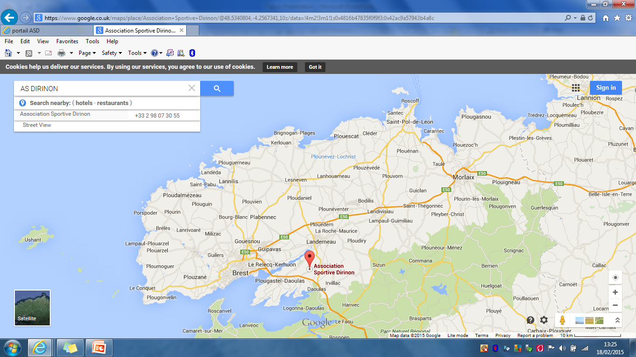

Slide 3
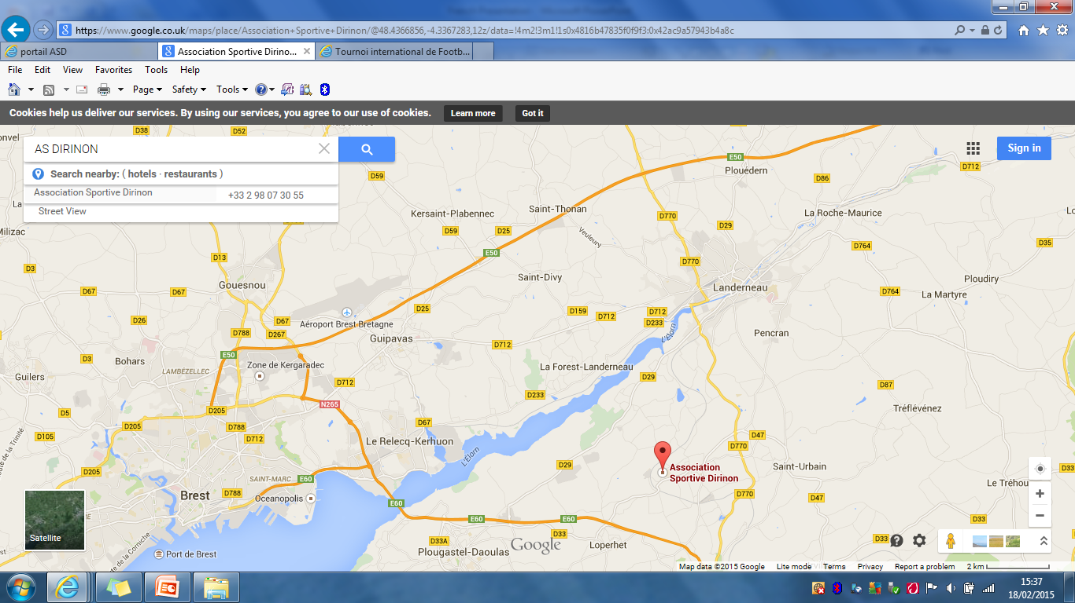

Slide 4
AS DIRINON
FORMED IN 1968
3 Adult Men’s teams
2 adult female teams
13 youth teams ( Boys, Girls & Mixed from U6s – U17s)
Vets team
Currently 6th in the 2nd division of their district – equivalent to the swpl (west)

Slide 5
DIRINON FOOTBALL CLUB

Slide 6
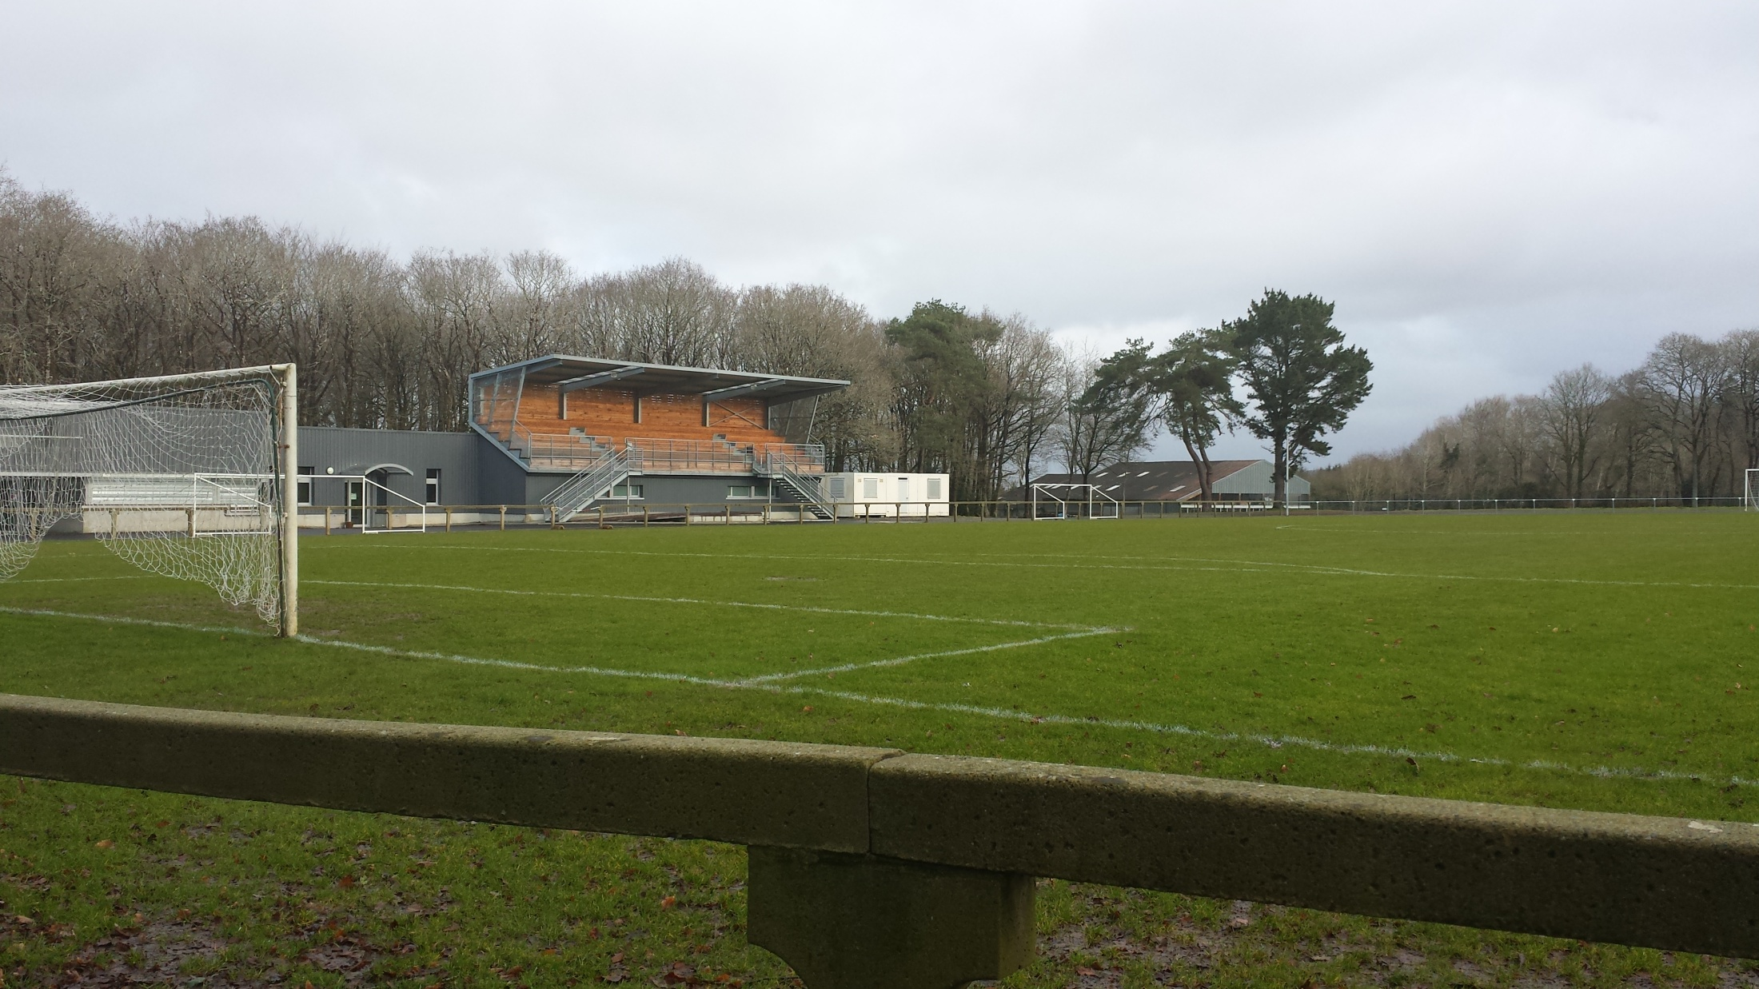

Slide 7
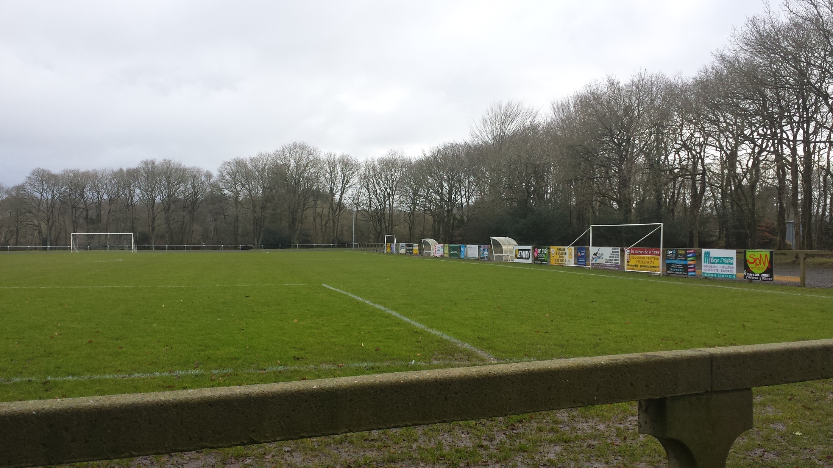

Slide 8
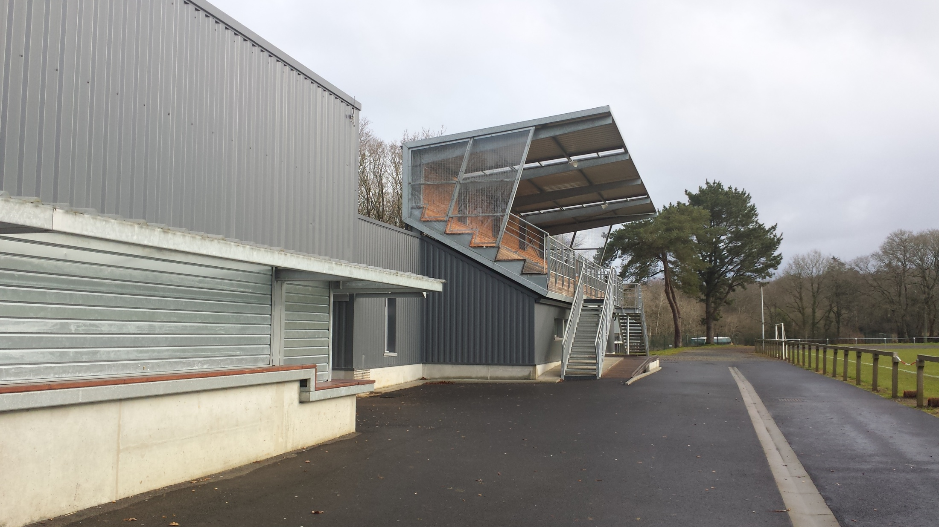

Slide 9
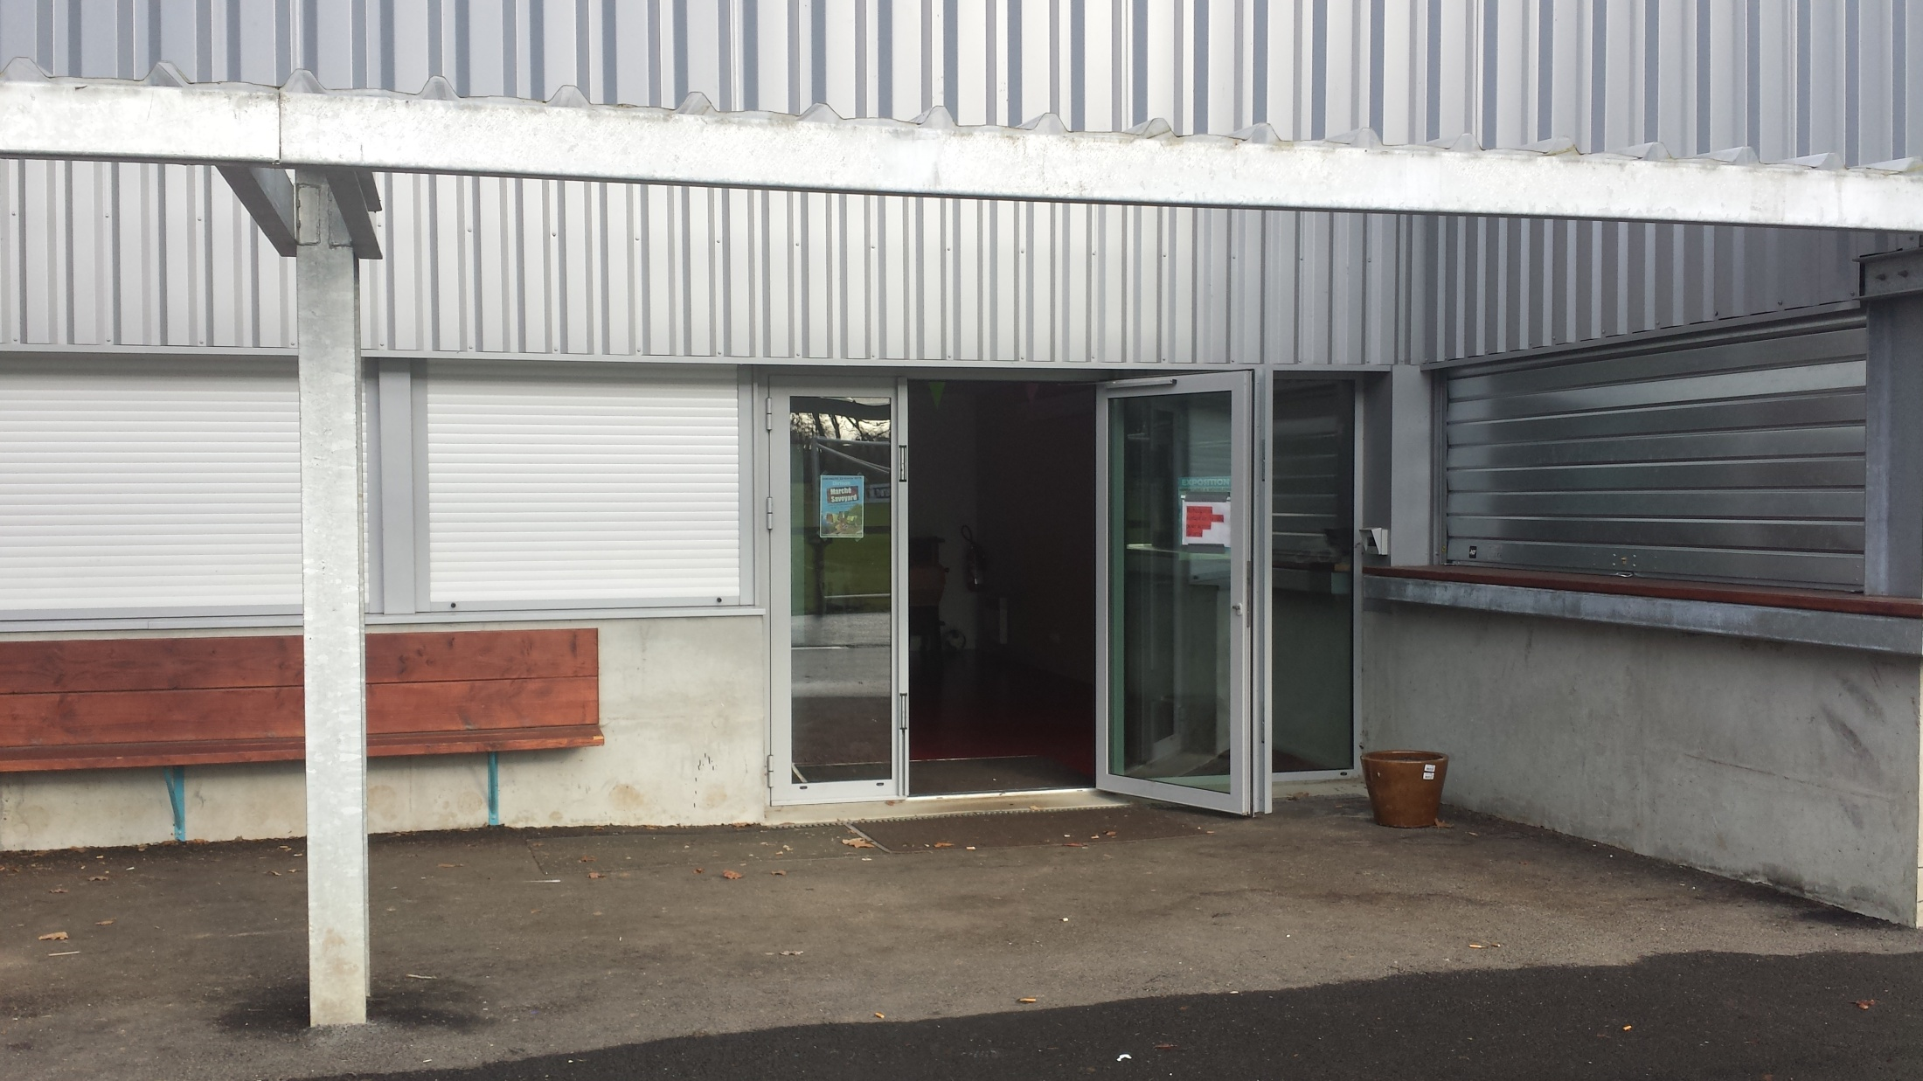

Slide 10
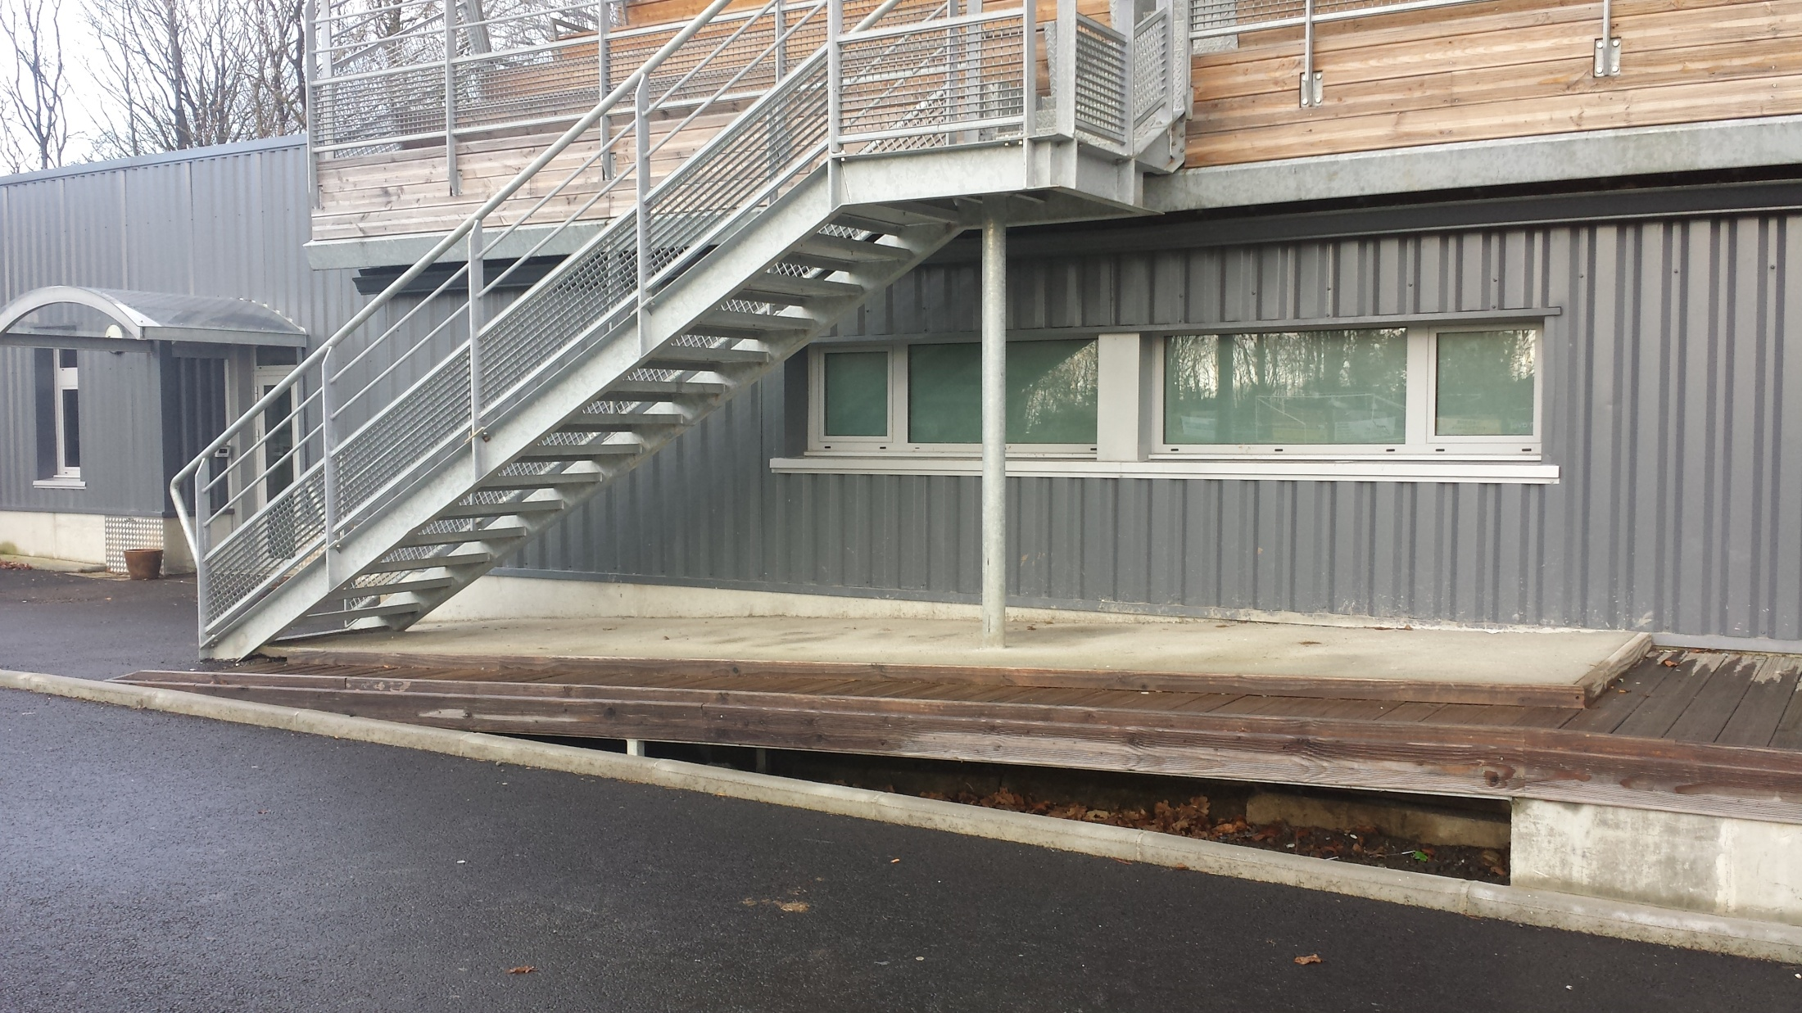

Slide 11
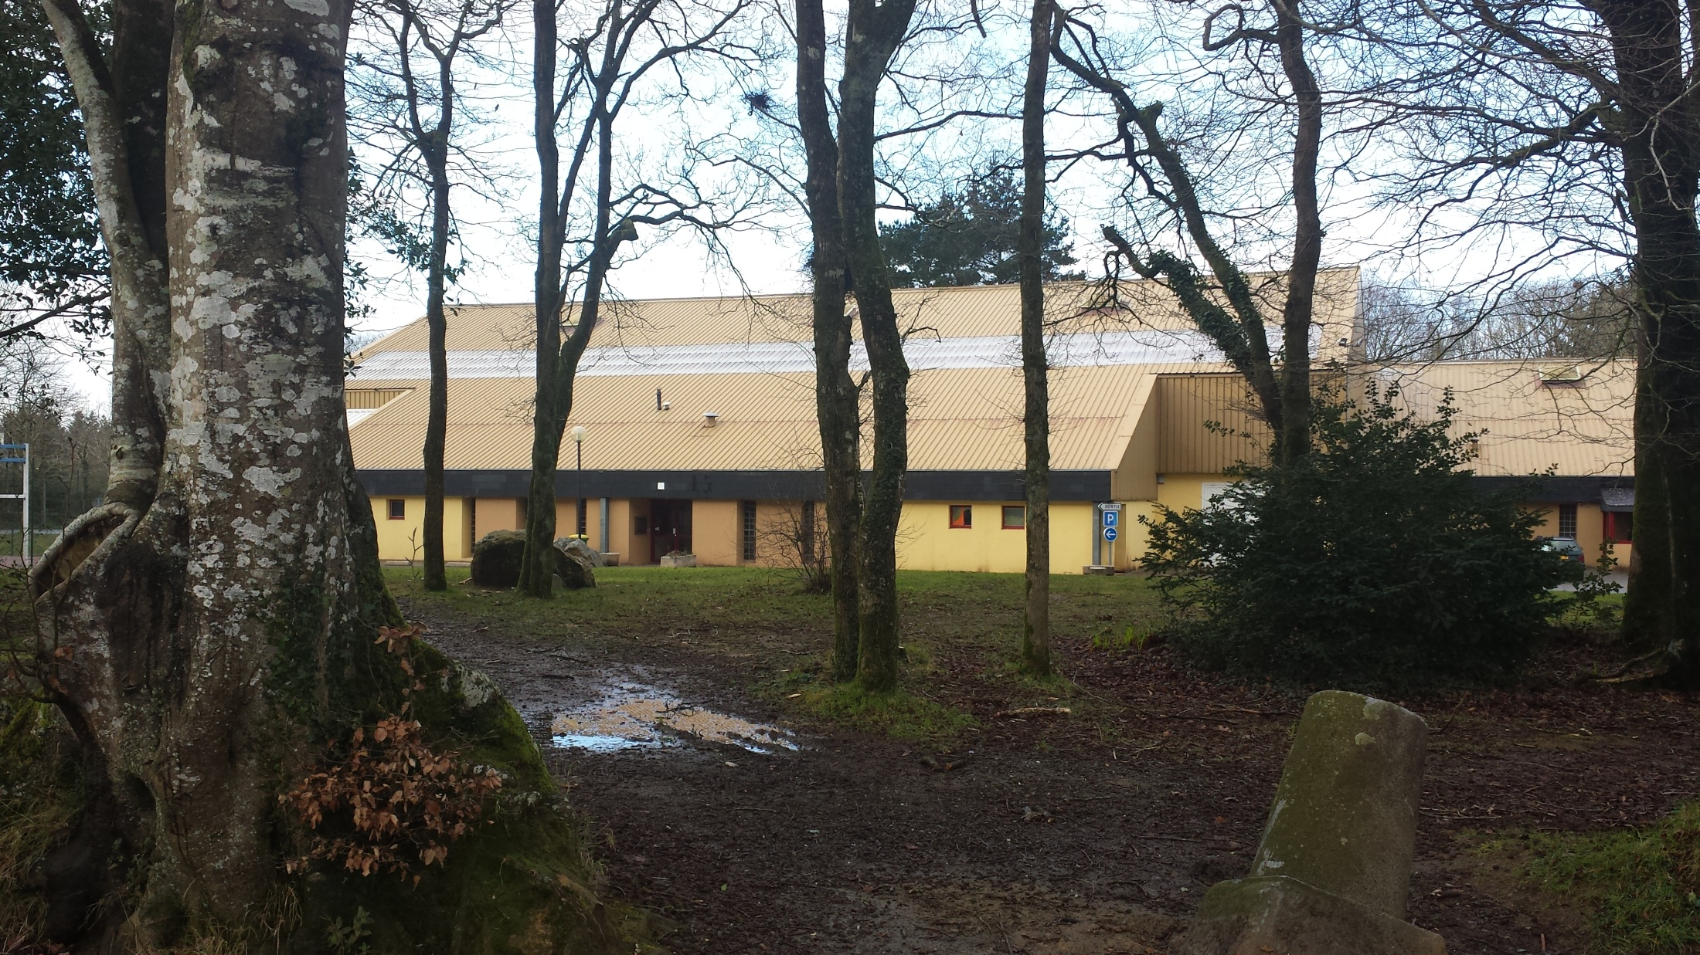

Slide 12
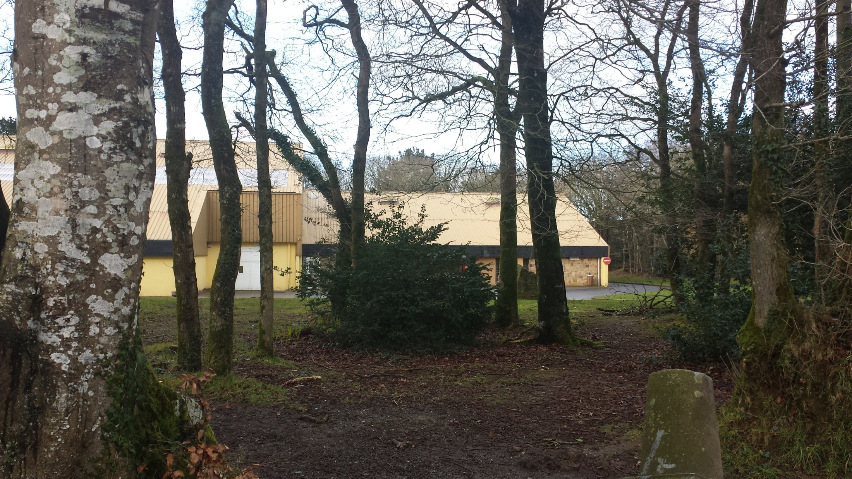

Slide 13
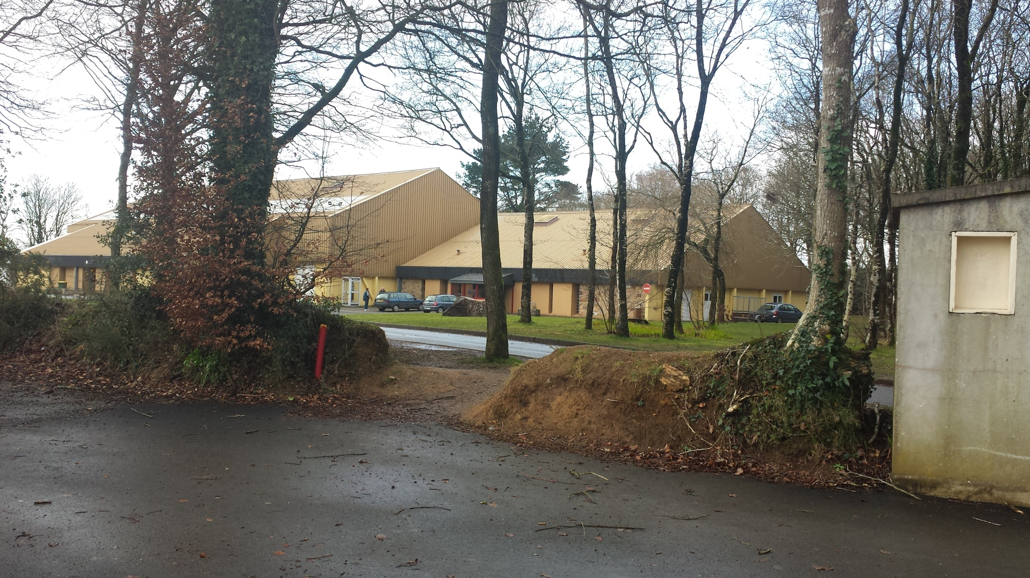

Slide 14
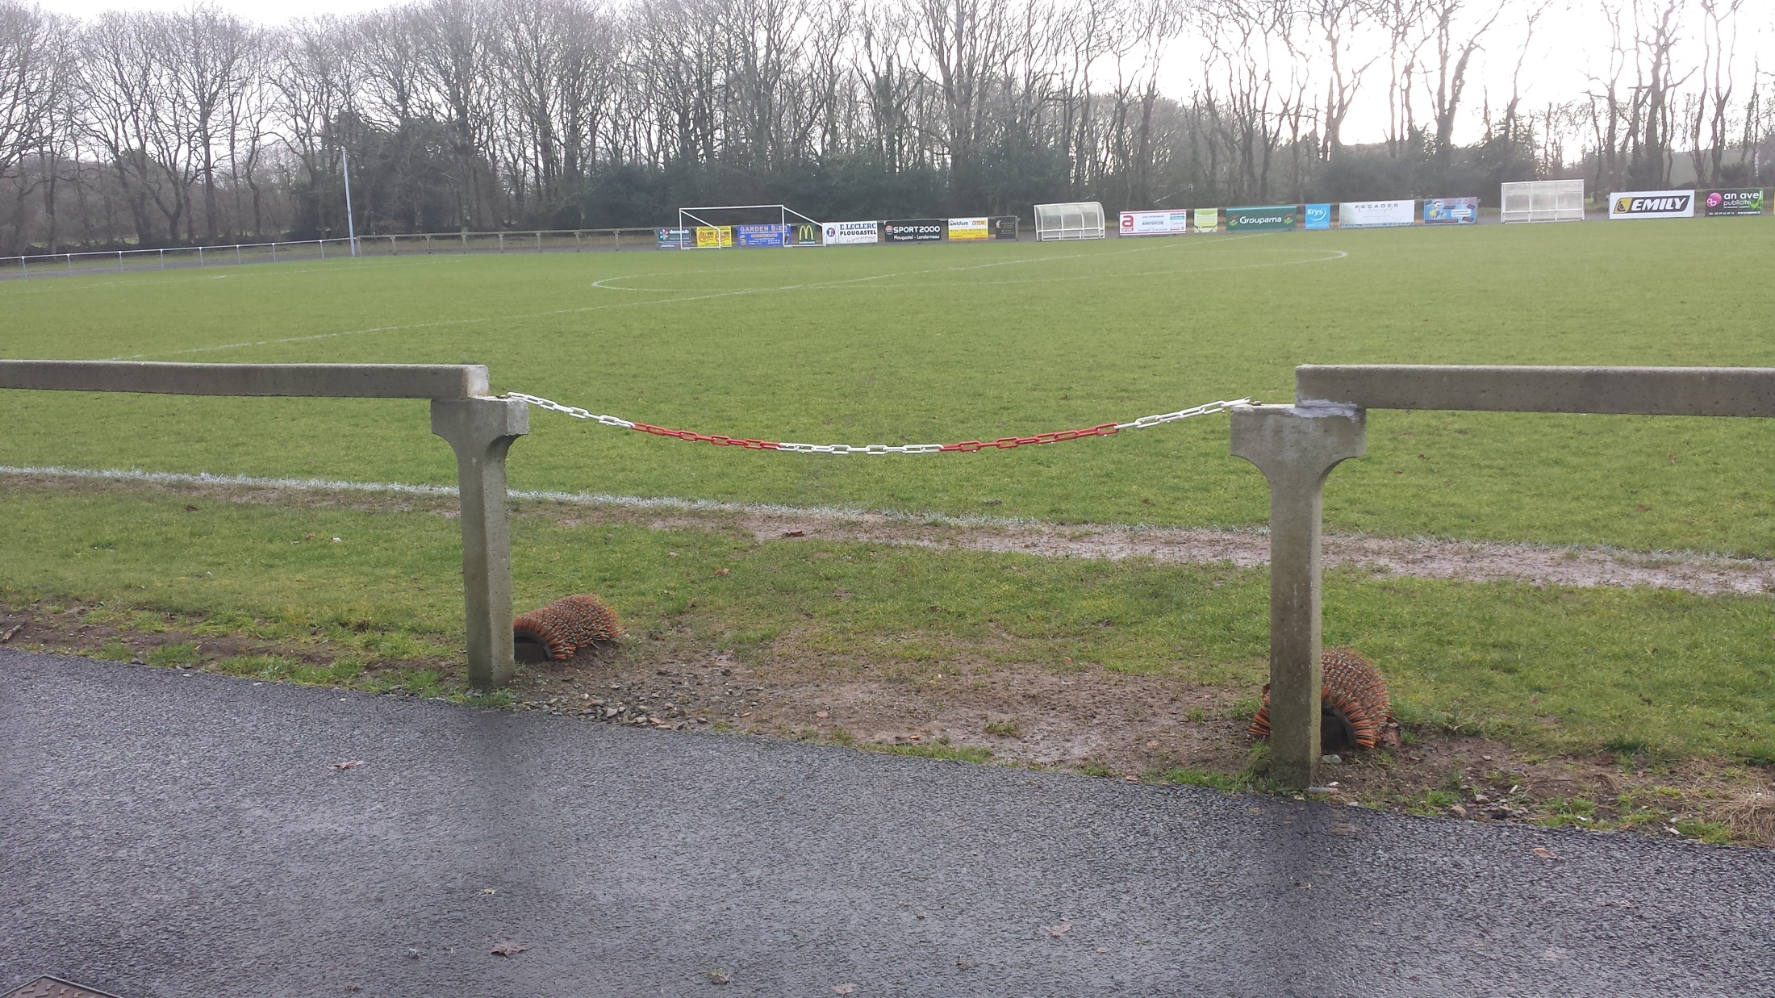

Slide 15
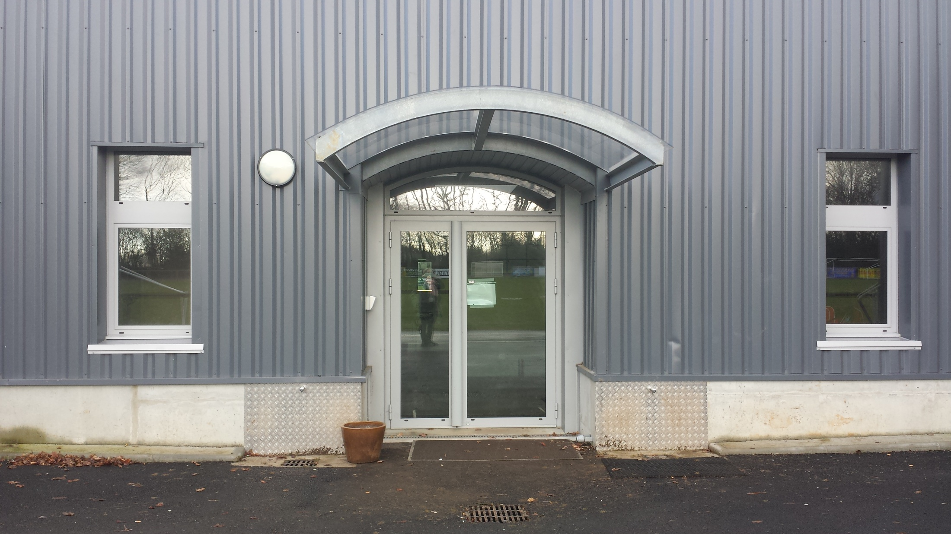

Slide 16
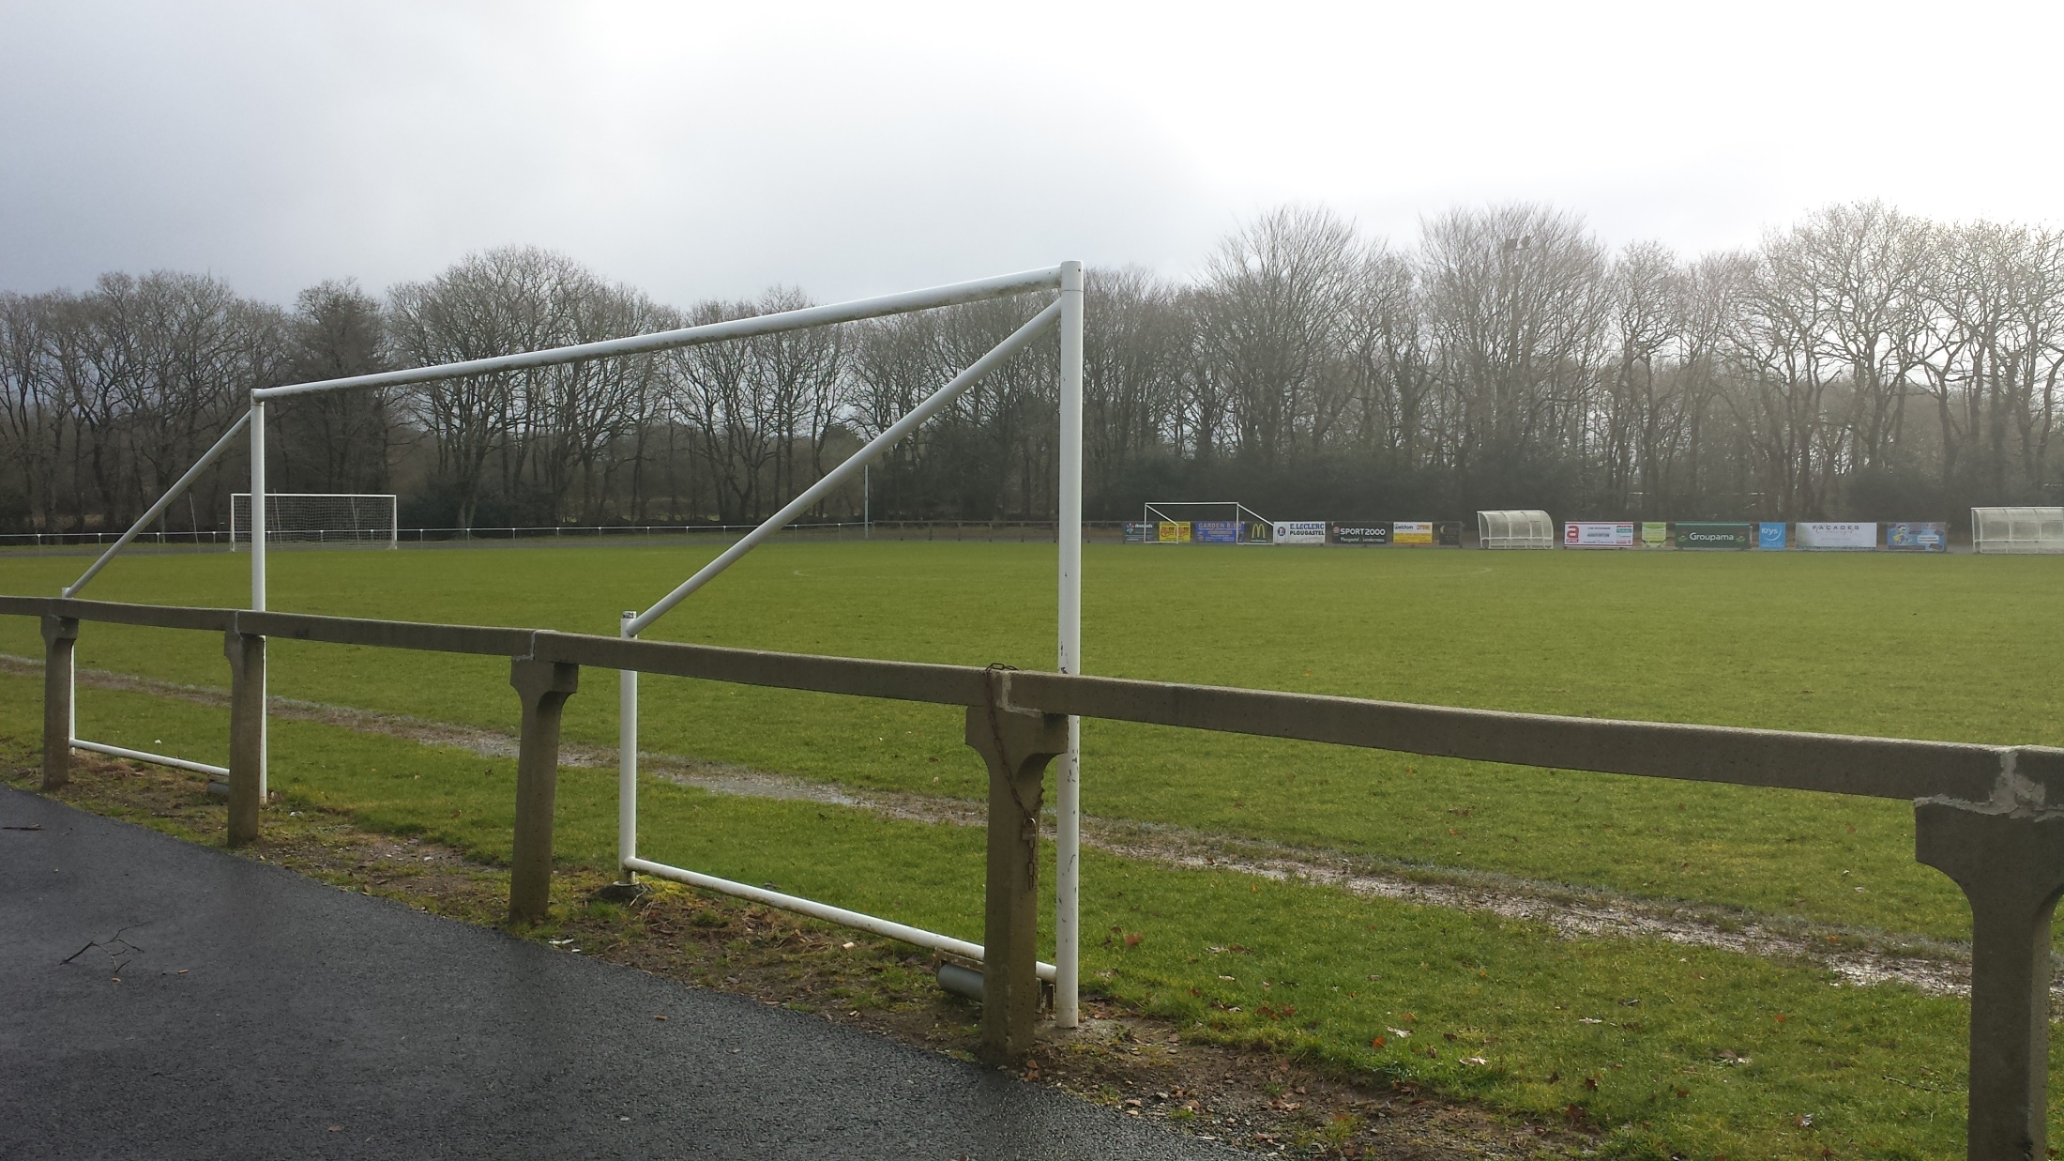

Slide 17
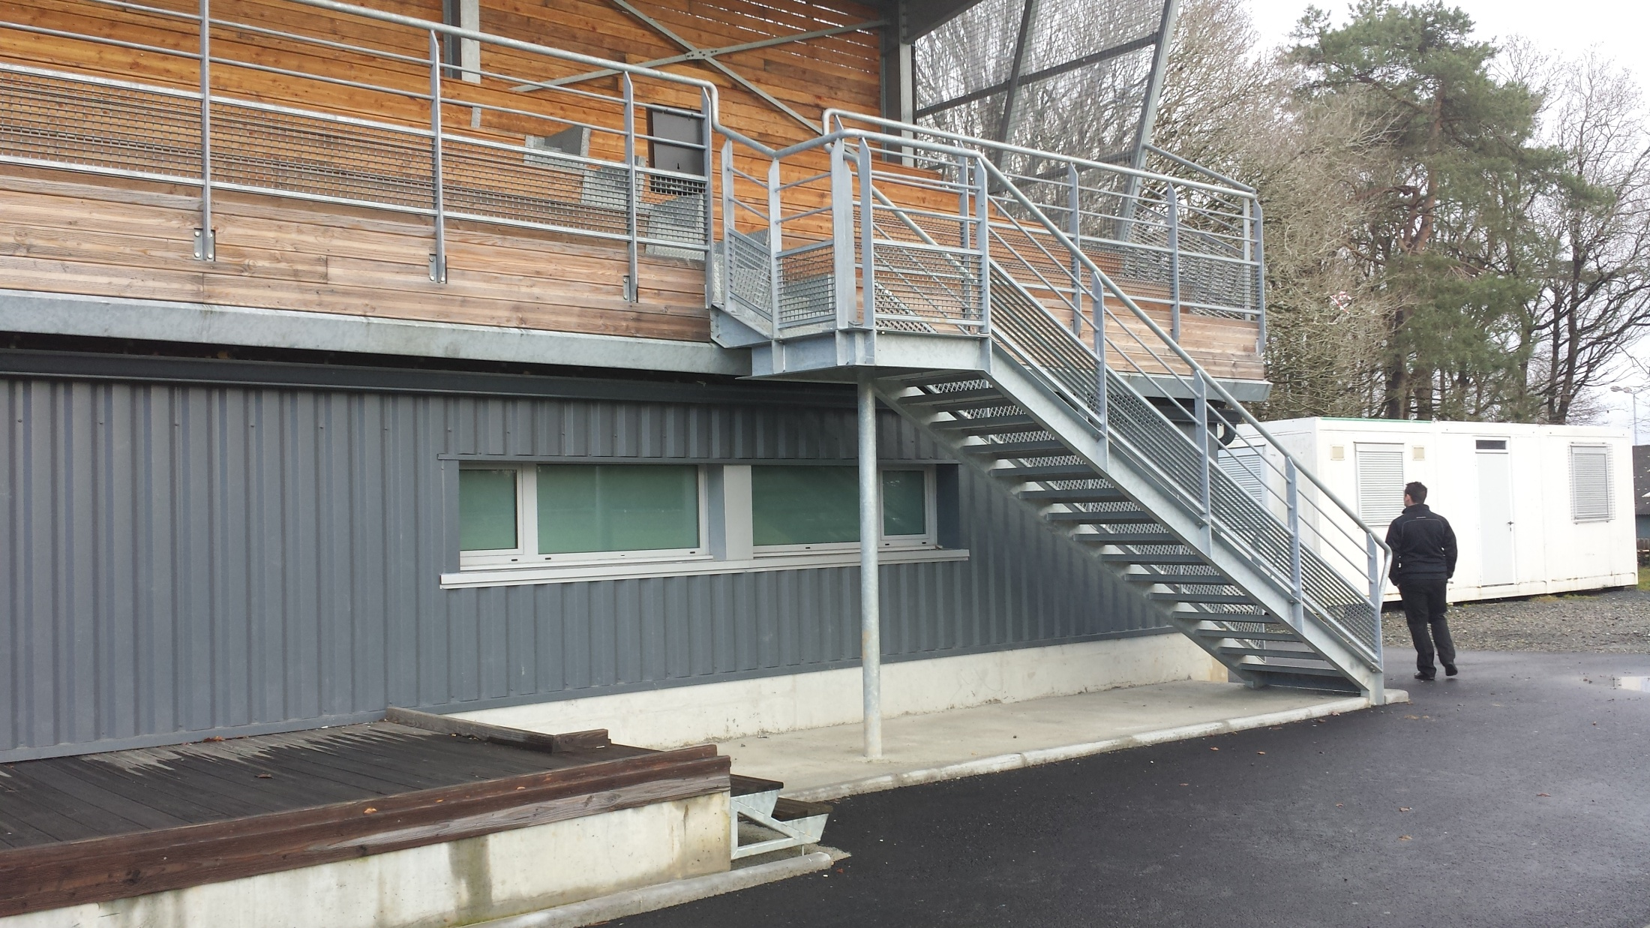

Slide 18
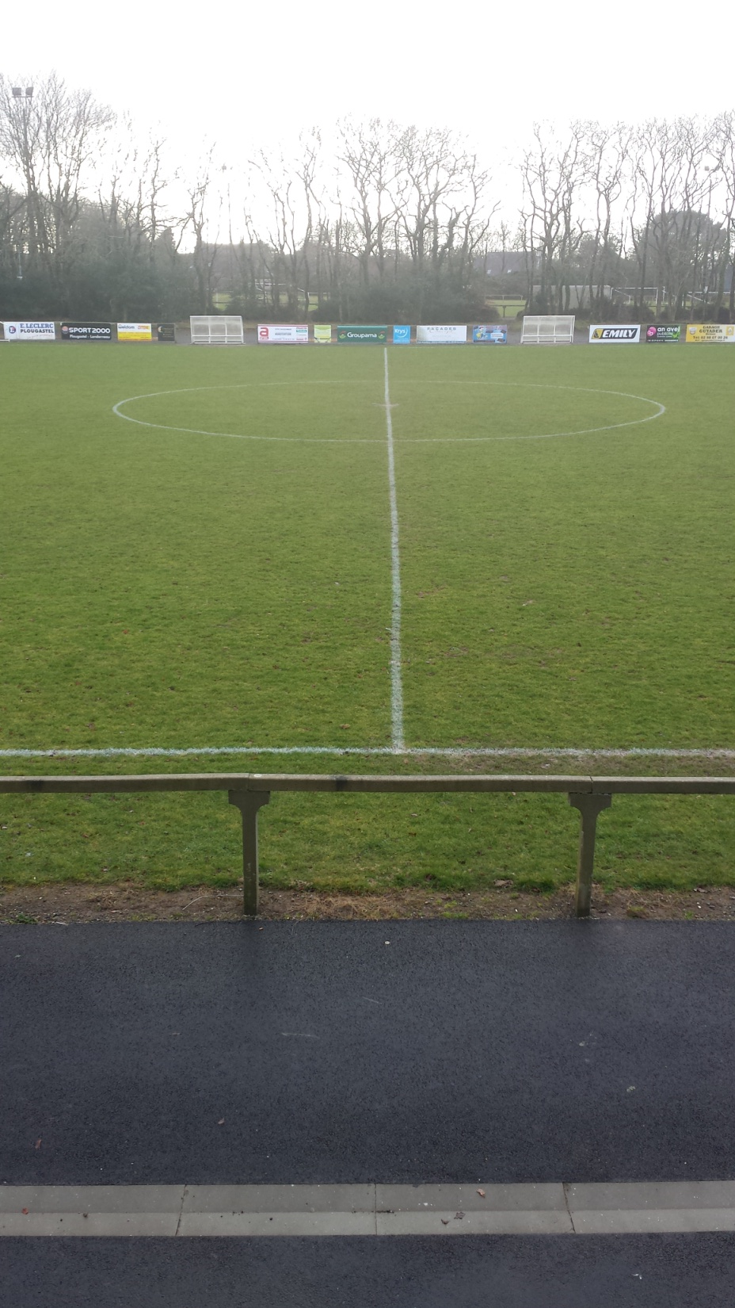

Slide 19
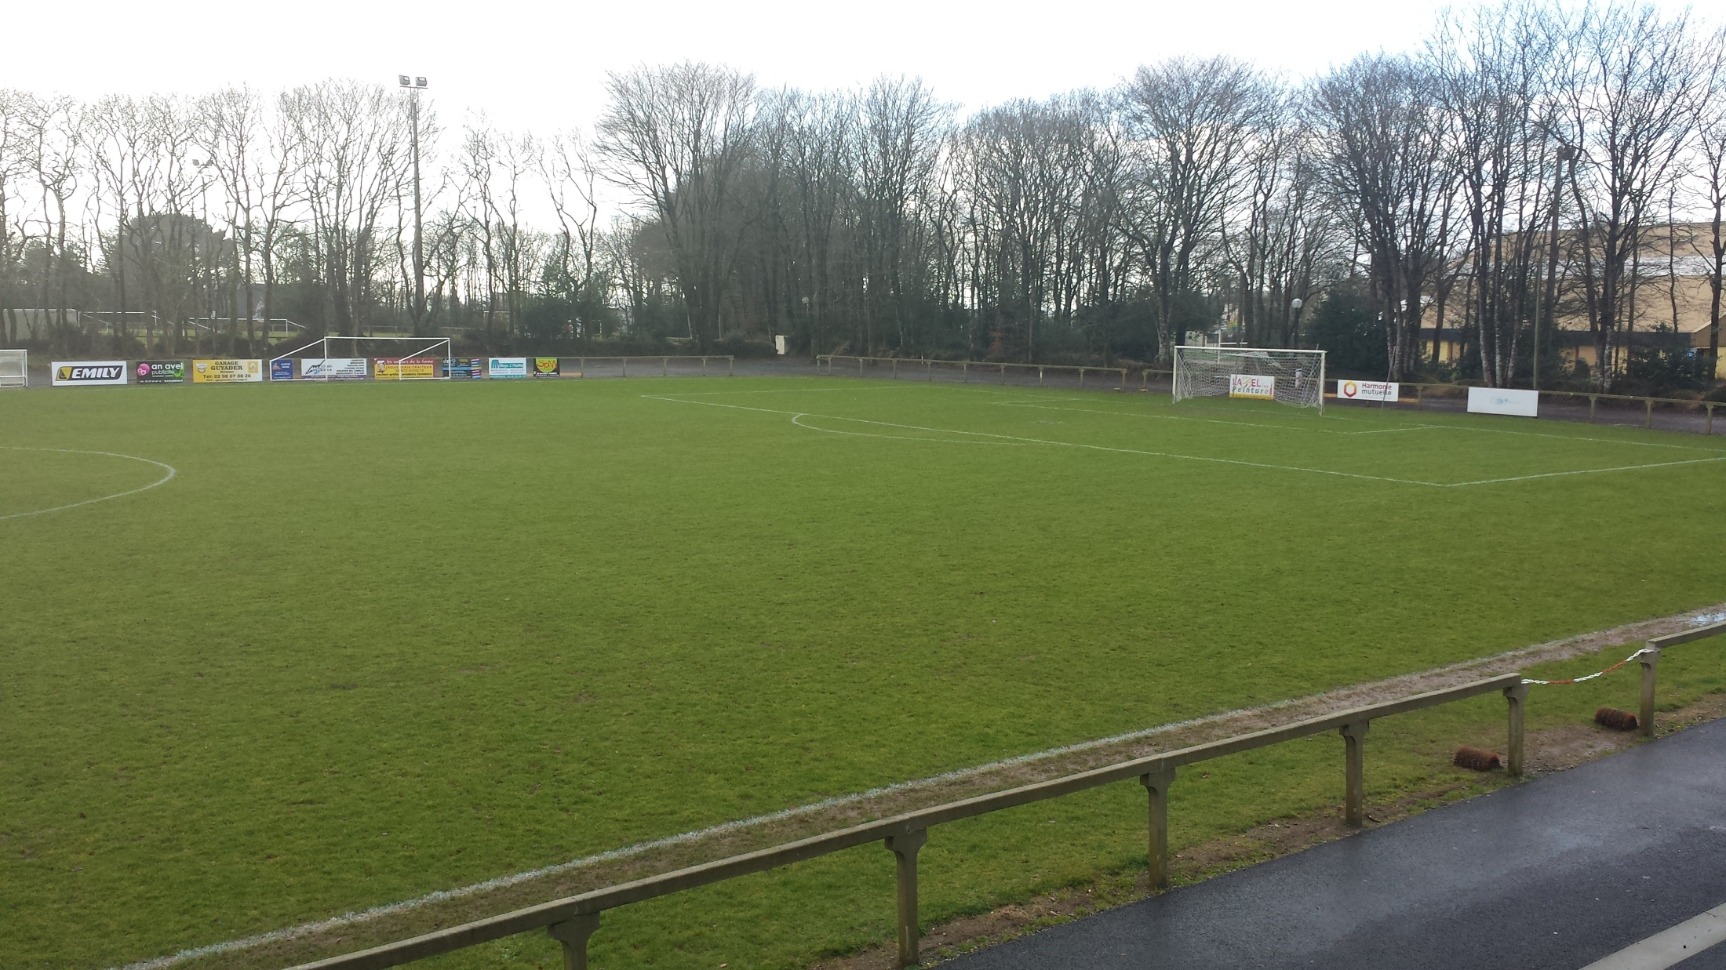

Slide 20
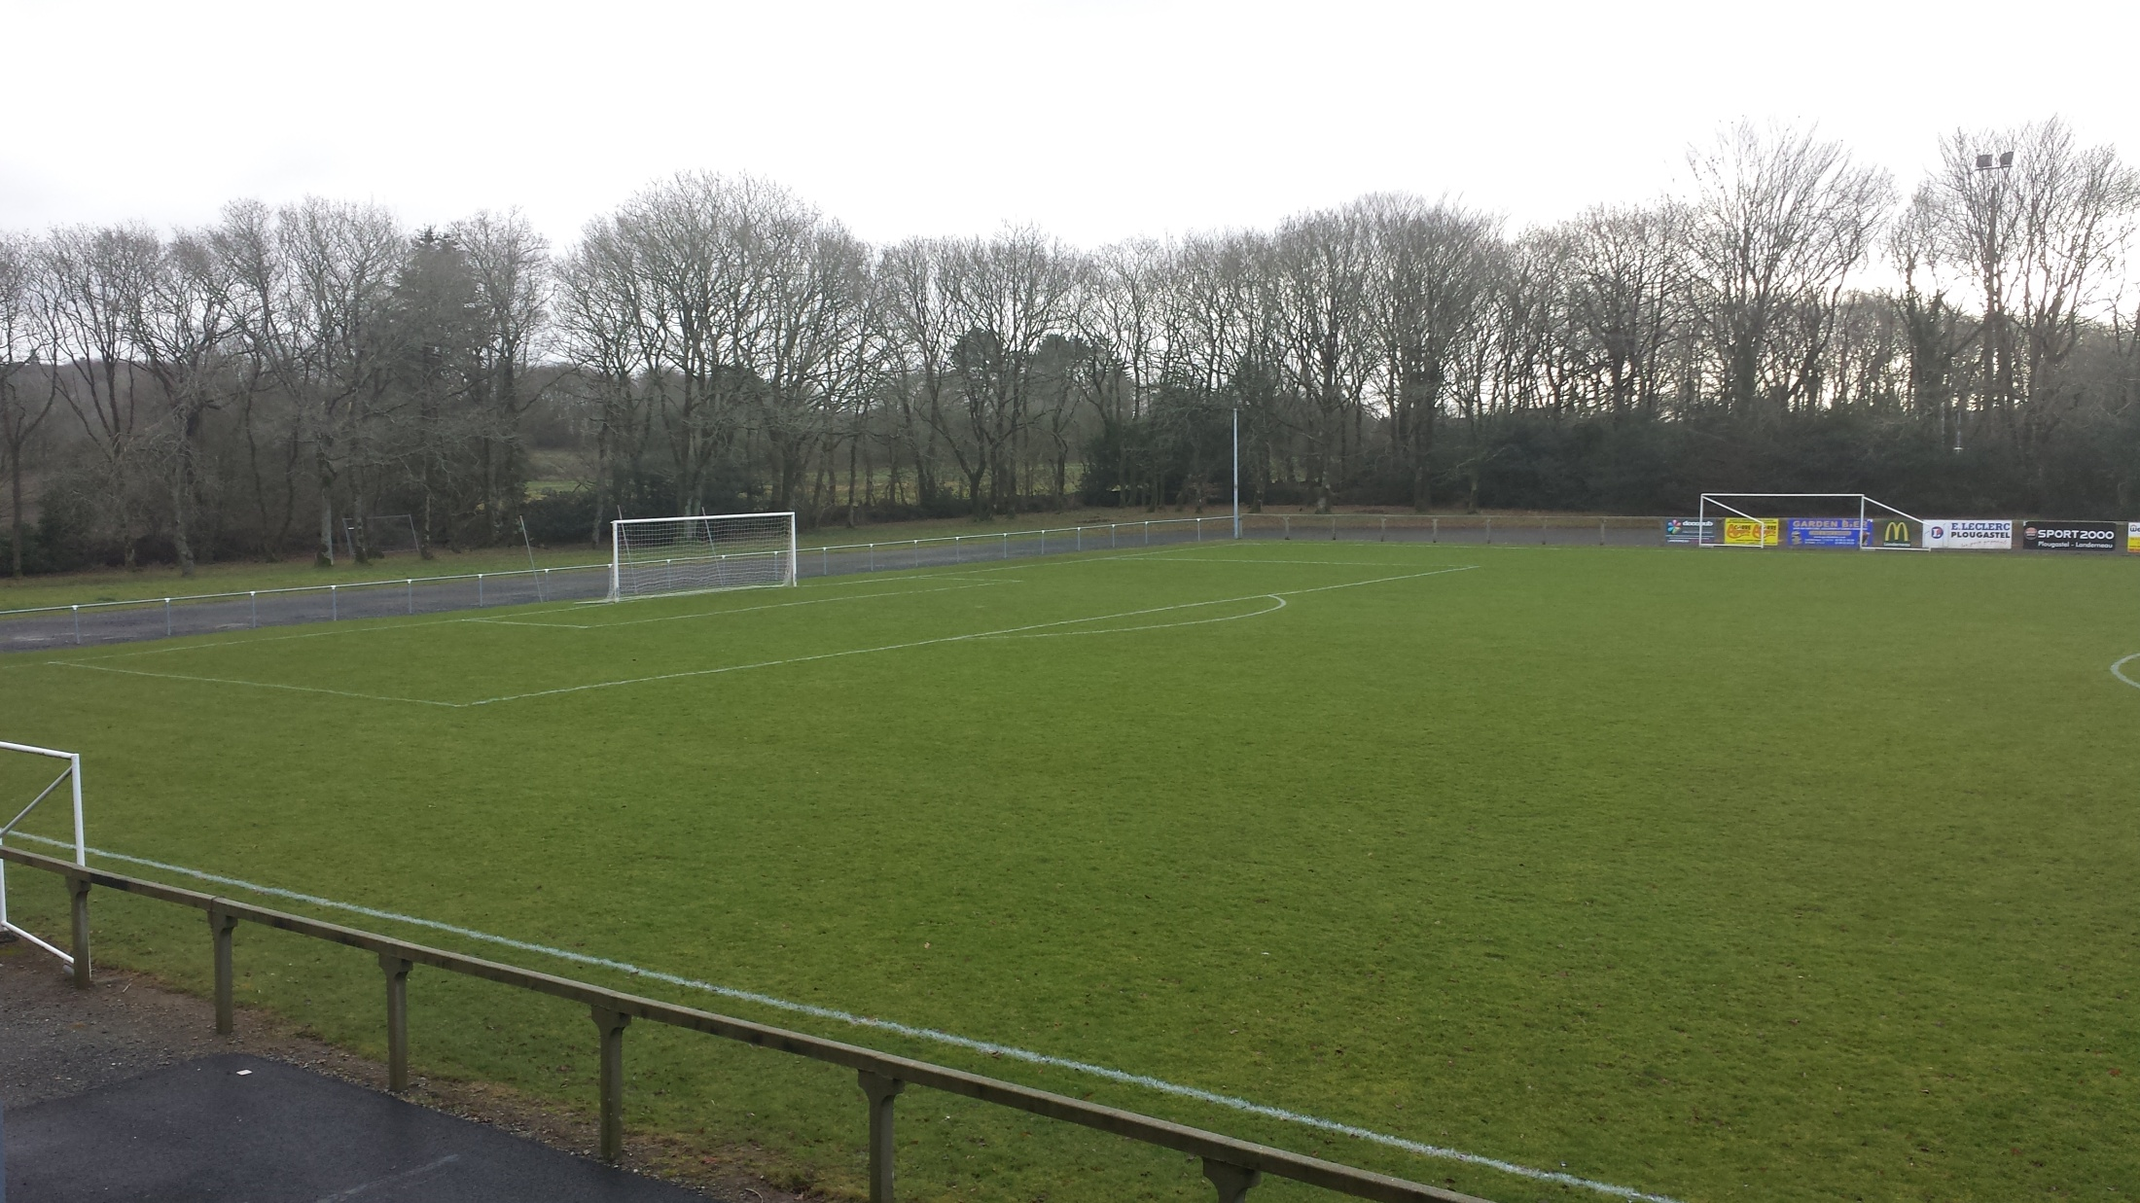

Slide 21
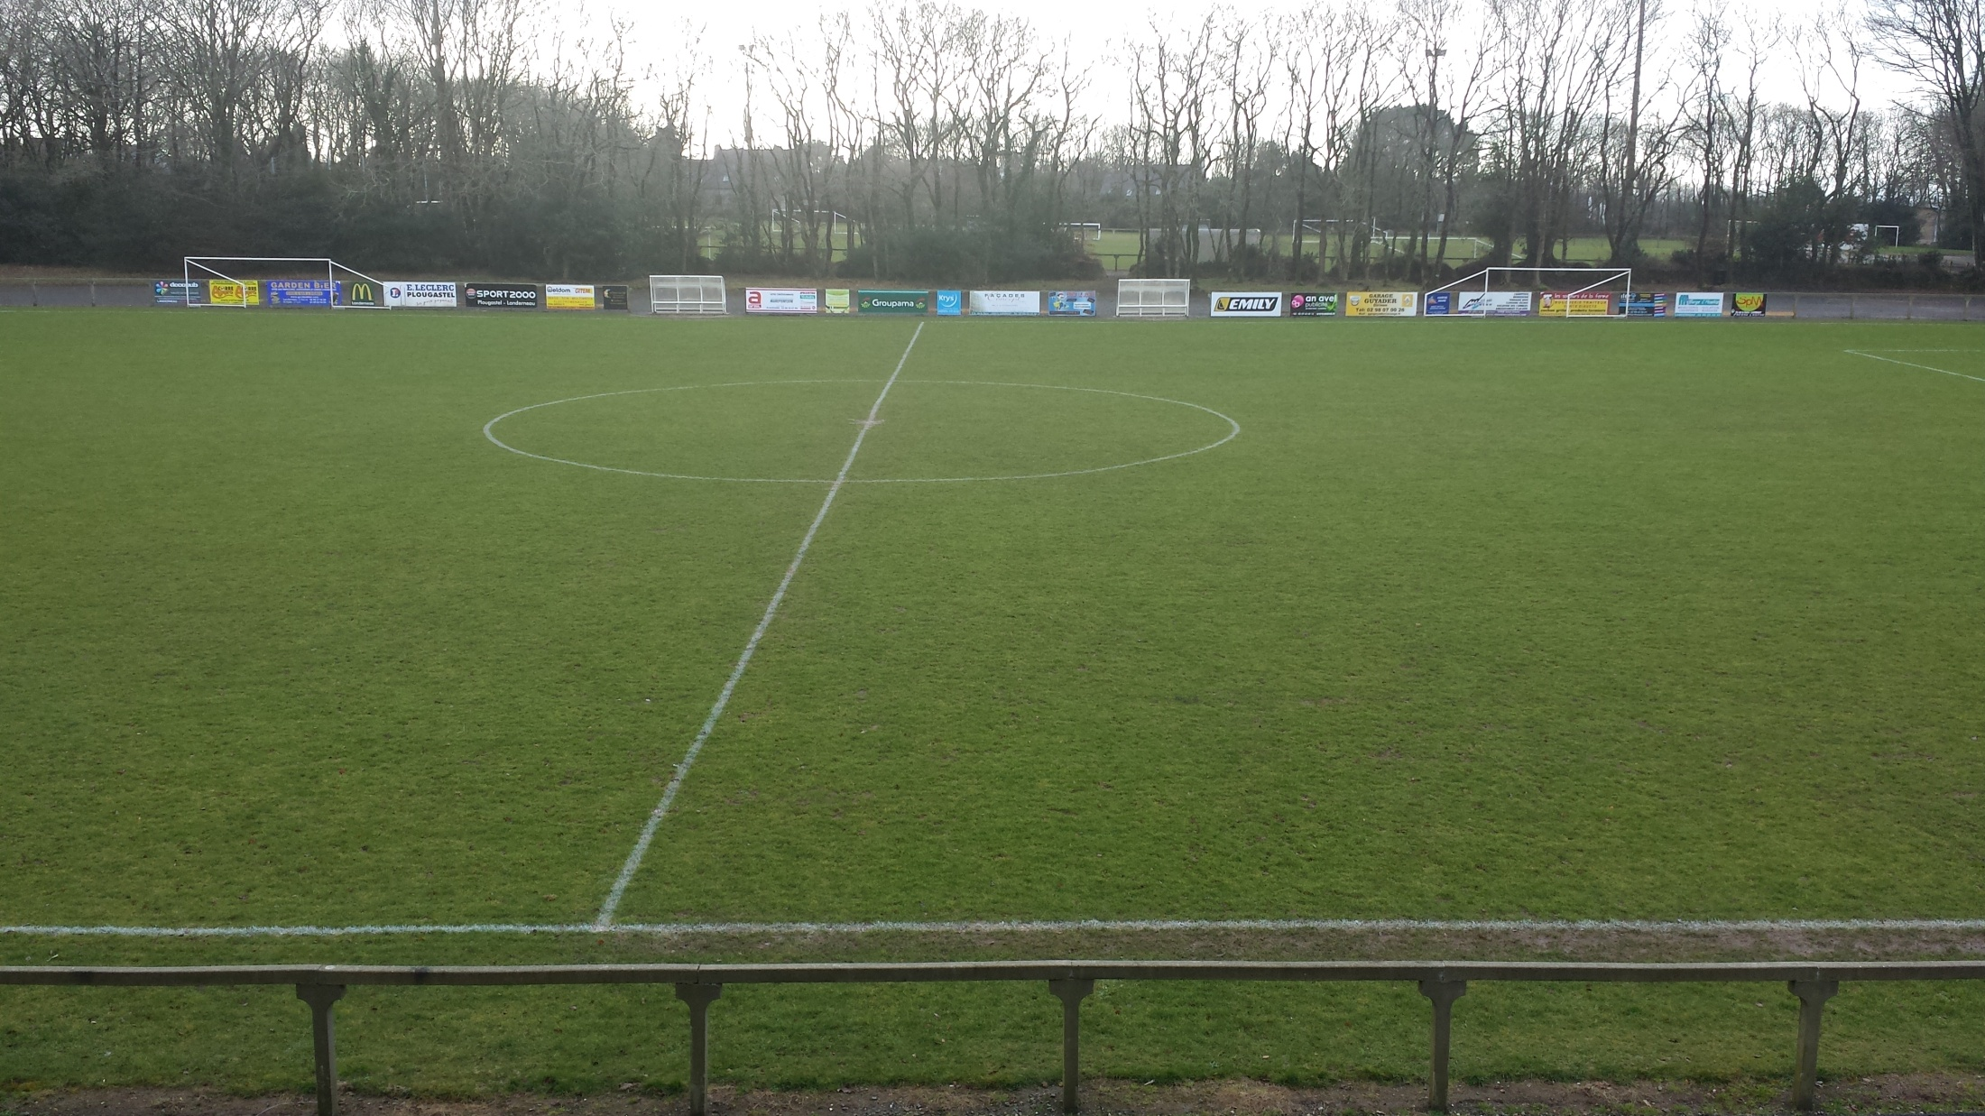

Slide 22
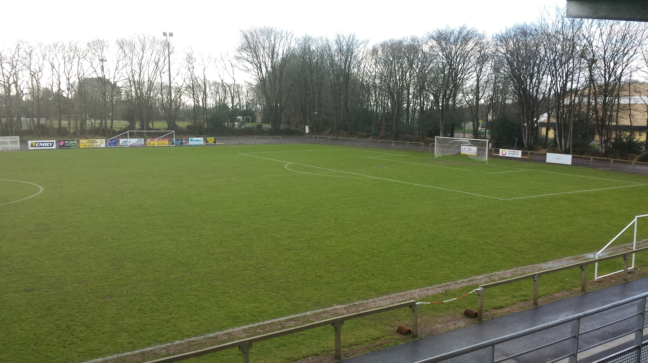

Slide 23
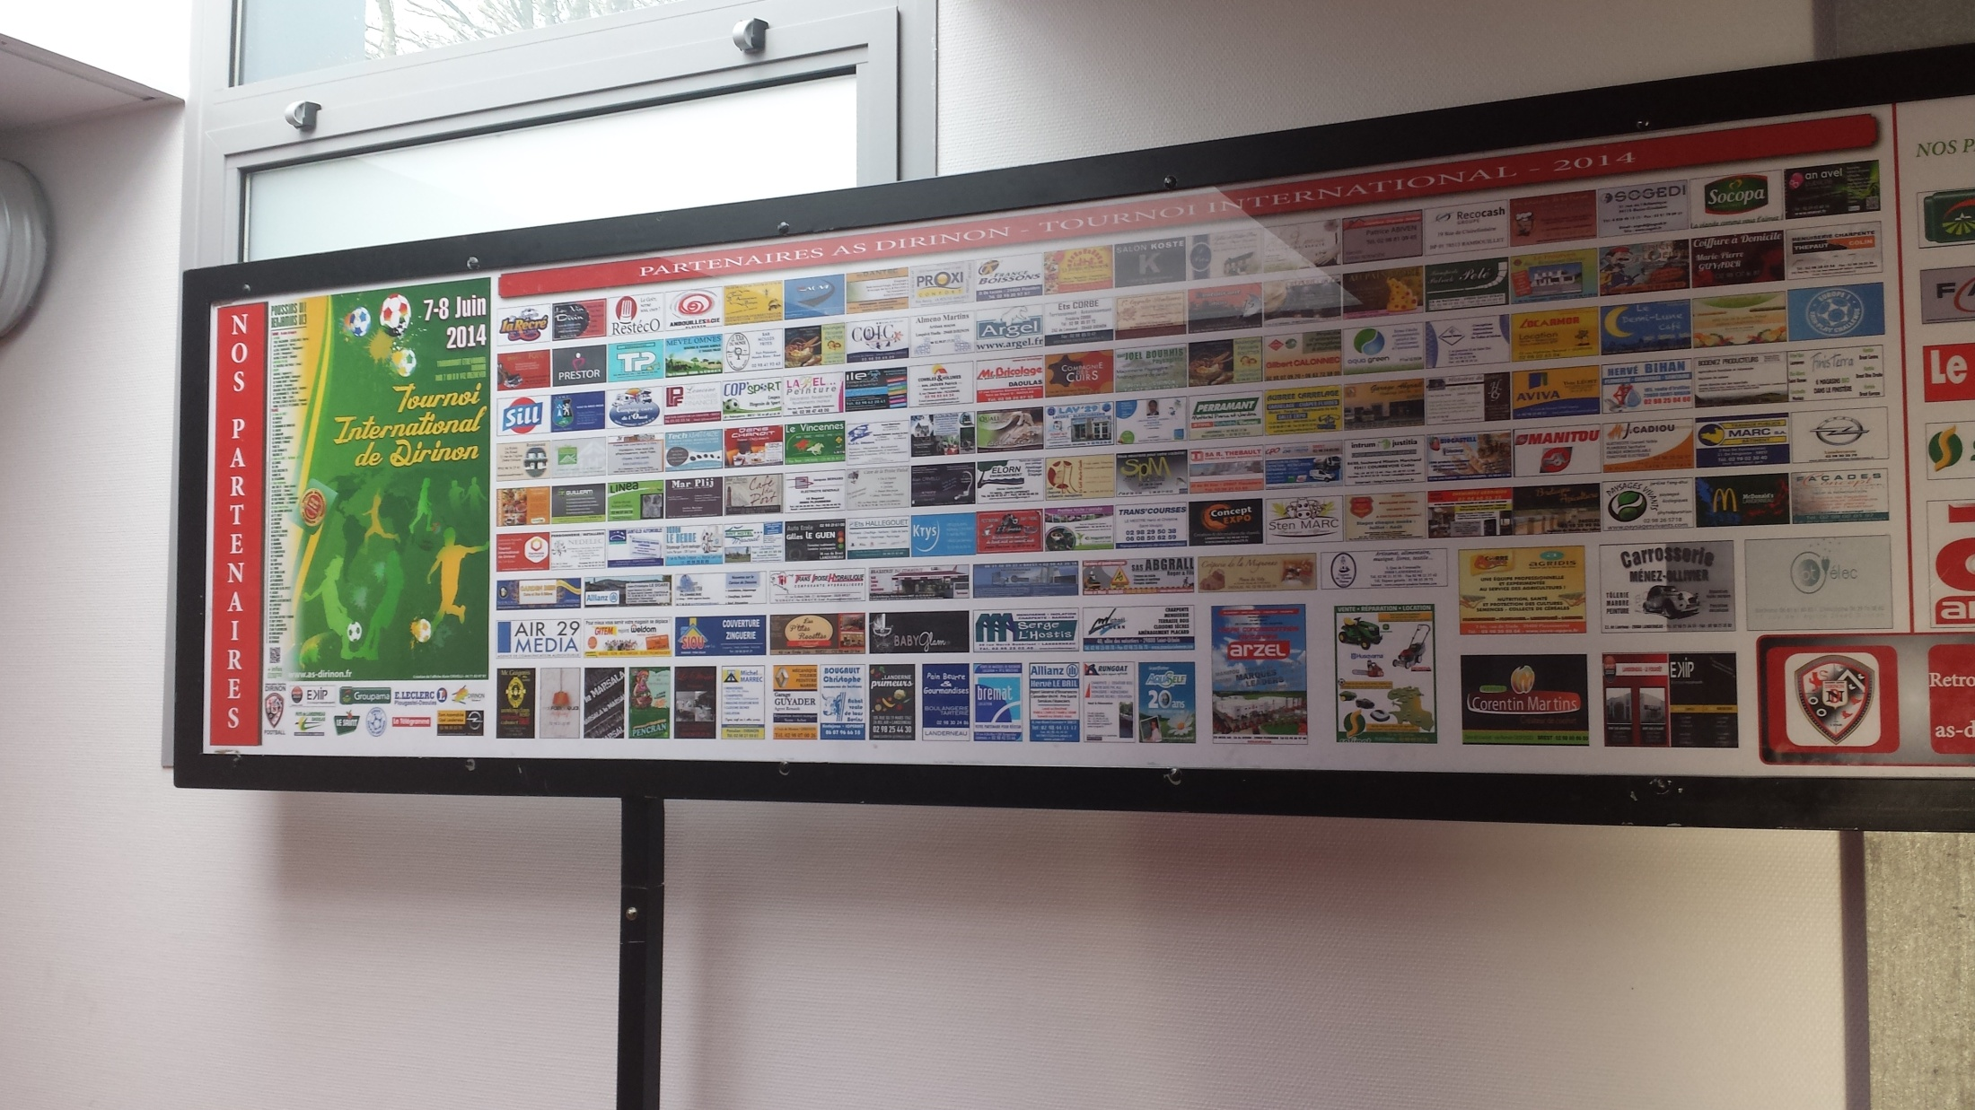

Slide 24
Tournament 2016
The tournament is in its 22nd year
90 teams across to age groups (U11s & U13s)
Two days of football
Played across 9 grass fields
Day 1 consist of a march to the town hall for an official opening 8:30am, games commences at 10am.
Day 2, depending on your league position in day 1, top 2 play in the cup competition, the rest of the league play in the plate competition.
The final last year was watched by approx 6,500 people.

Slide 25

Video 1

Slide 26
ABOUT THE HOTEL

Slide 27
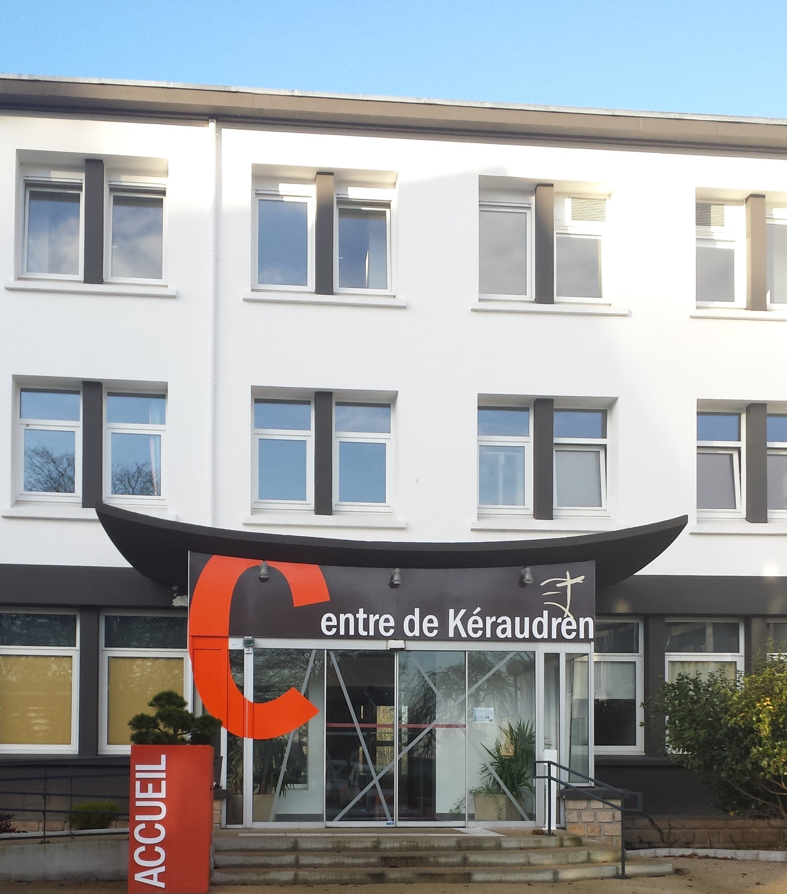

Slide 28
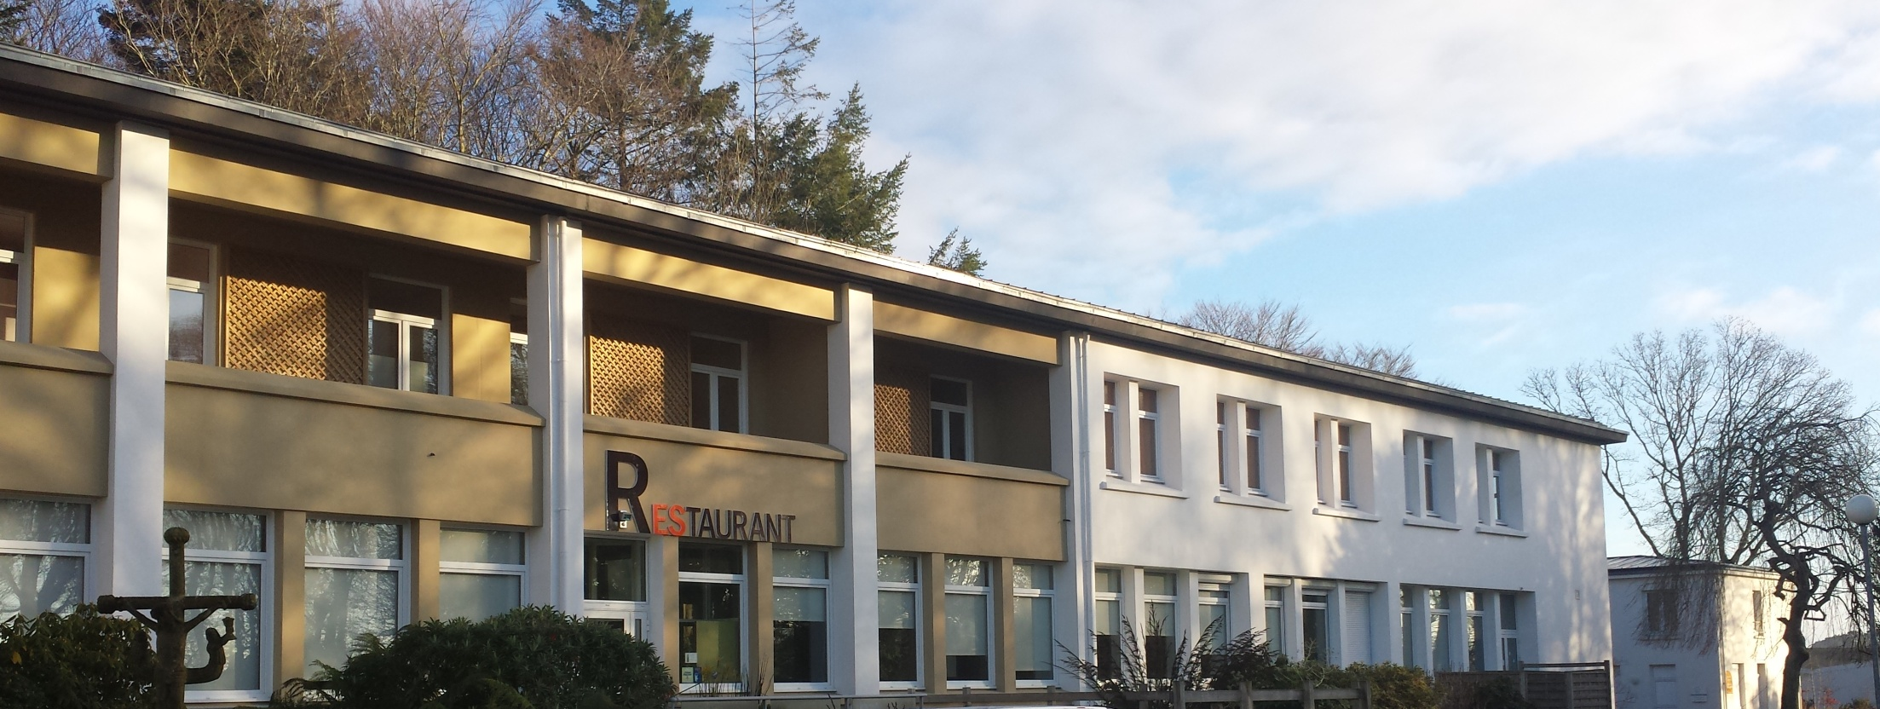

Slide 29
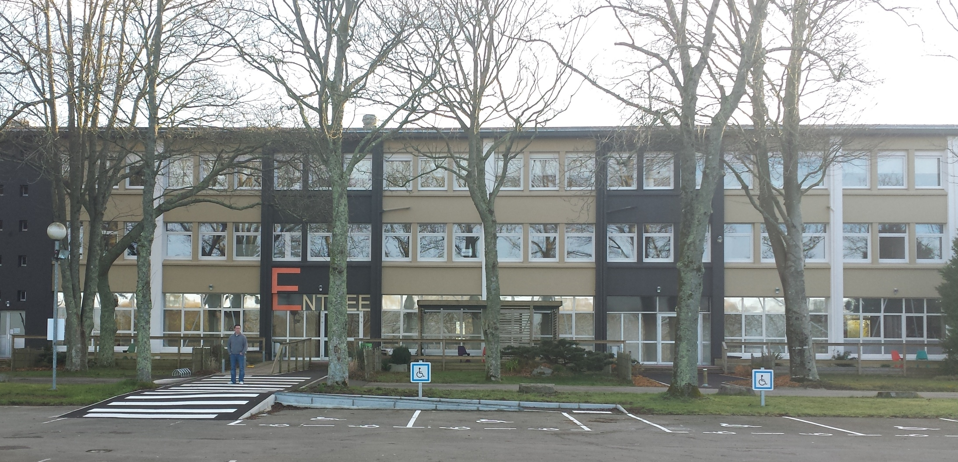

Slide 30
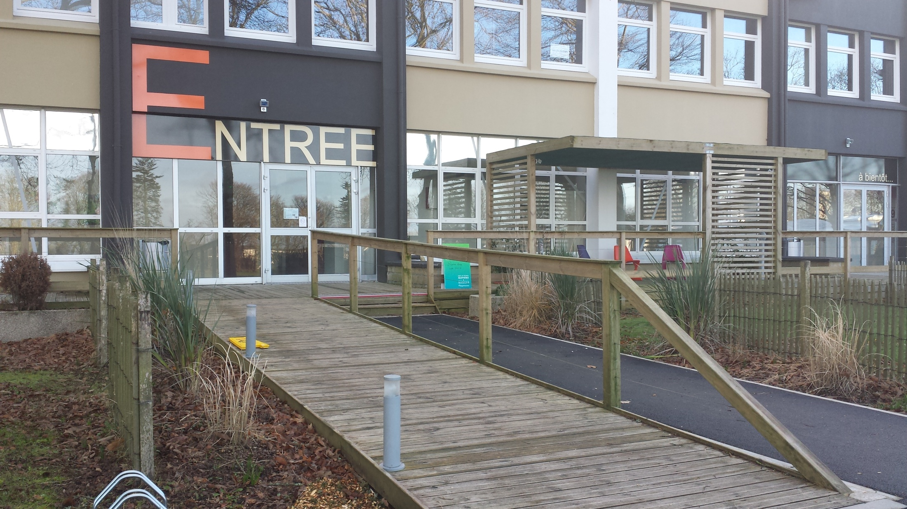

Slide 31
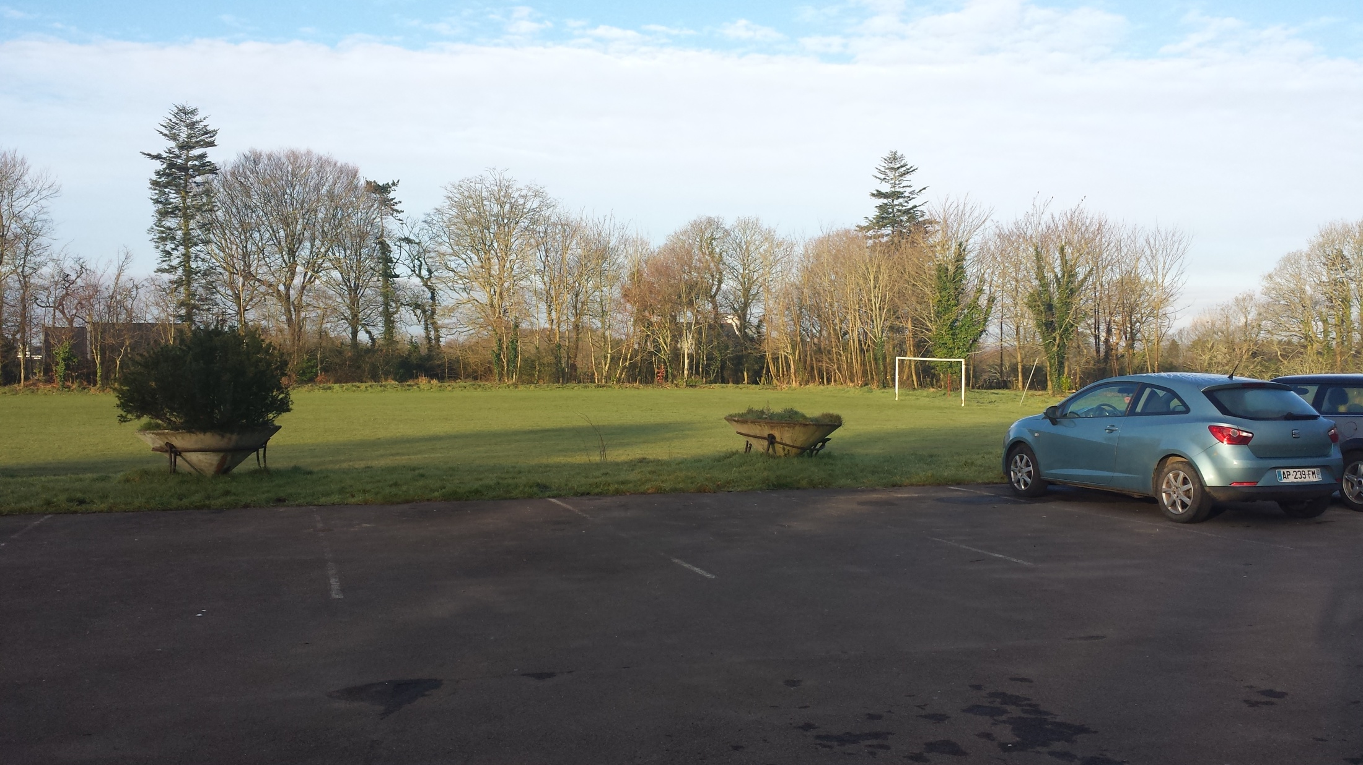

Slide 32
COST (Child)
£240 per child
Tony Evans & I will each give £10 each per child so already the price has drop £20
£220 per child

Slide 33
SPONSORSHIP SO FAR
Dash Self Drive
Barclays Bank (Price match upto £1000)
Bag Packing (Friday 25th March)
Horse Race Night ( Fri 19th Feb)
The more we raise the cheaper it gets

Slide 34
ANY QUESTIONS ON THE LINK
ST DAY AFC & AS DIRINON

